Slide 1
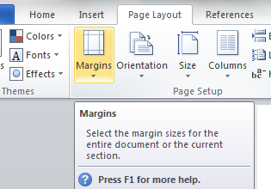
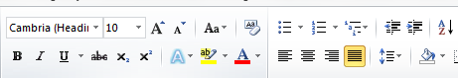

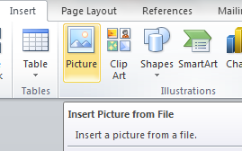
Chapter 17: Document Production (Word)
Task 4 - LG investigates Smart TV 'unauthorised spying' claim
Using a suitable software package (Word), load the file LG Smart TV.RTF Page Layout Set the following Margins/Page Size – Set all margins to – 2CM Set the page size to A4 Set the page orientation to Portrait. Header – Name - (Left) Footer – File Name (Left) Date – (Right)
Text Formatting Insert this title at the start of the document LG investigates Smart TV ‘Unauthorised Spying' Claim (apply Title Style) Below the title, add a subtitle -- Report by: and add your name (apply Subtitle style). Apply the Body Text style to remaining text and format into two columns (1.5 centimetre gap between the columns) Identify the subheadings and apply the Subheading Style.
House Style Specification Sheet Title: Sans Serif, Blue, 24 pts, Centre Aligned Subtitle: Sans Serif, Black, 22pts, Right aligned Subheading: Sans Serif, Black, Bold, Italic, 12 pts, Centre Aligned and one clear line space after each subheading. Body Text: Serif, Black, 1,5 line spacing, 12 pts and Justified. One clear line space after each paragraph.

Slide 2
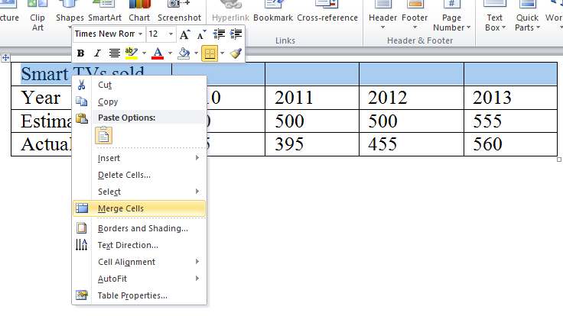
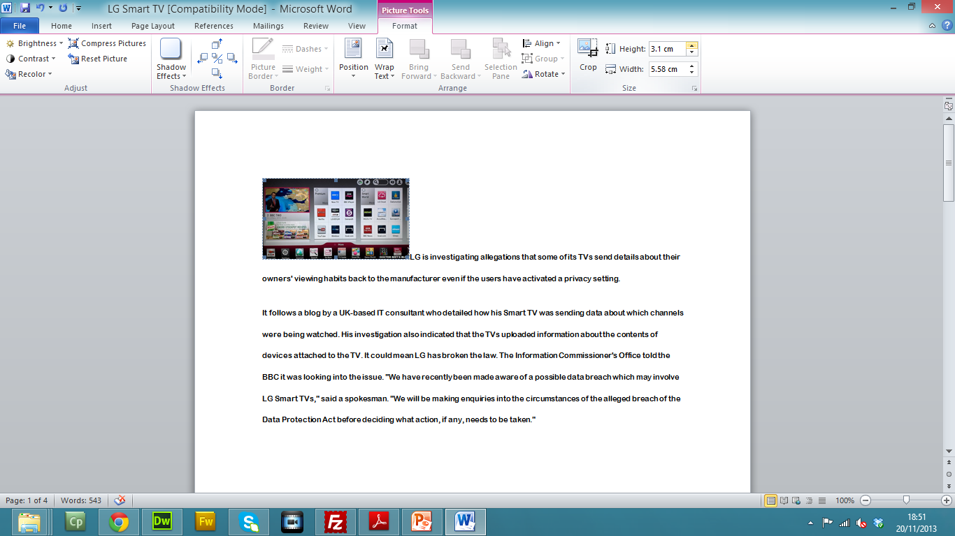
Chapter 17: Document Production (Word)
Task 4 - LG investigates Smart TV 'unauthorised spying' claim
Enter and edit data from different sources Find the table in Sales.RTF and insert it at the end of the document. Make sure the table fits within the column width. The font should match the body text of the document. Merge the cells in the top row of the table across the five columns. Format only this row to be centre aligned and underlined. Apply a light grey (20 – 40%) shading to only the top two rows of the table. Insert the Interface.JPG image On the first page Aligned to the left margin in the first paragraph Re-size the image to a height of 2cm and maintain the aspect ratio. Change the wrap text to tight. Spell-check and proof-read the document.

